Slide 1



Data Visualization and Dashboards with Tableau (New York City Airbnb Dataset) by Abi Afolabi 7th August 2023

Slide 2

Project Overview & Goals
Practice using Tableau for visualization, dashboard design and storytelling
Turn data into easily consumable visual insights.
Create impactful dashboards that help stakeholders make decisions that address business questions and/or problems.
Communicate insights with the correct visualizations.

Slide 3
Project Execution Steps: Option 2: New York City Airbnb dataset
Imported data into Tableau
Created Charts to understand the data
Create NYC Airbnb Dashboard & Story
Answer Question with Charts
Generate “Thought Provoking Questions”
Notes:
POIs are Restaurant & Employment Services

Slide 4
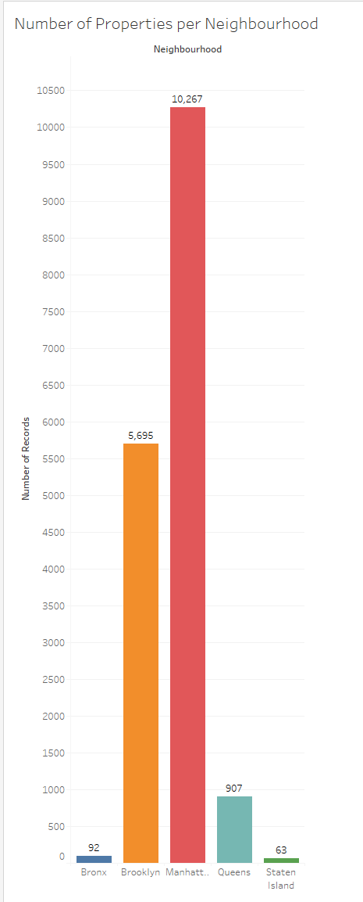
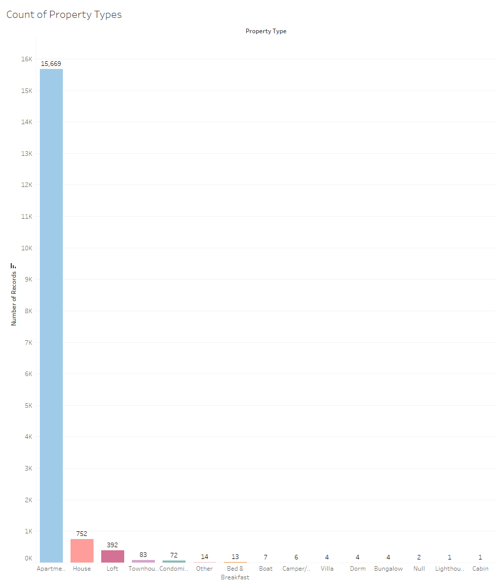
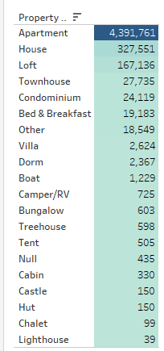
Understanding the Dataset
5 neighborhoods offering Airbnb services
15 property types
Apartments generated the highest revenue

Slide 5
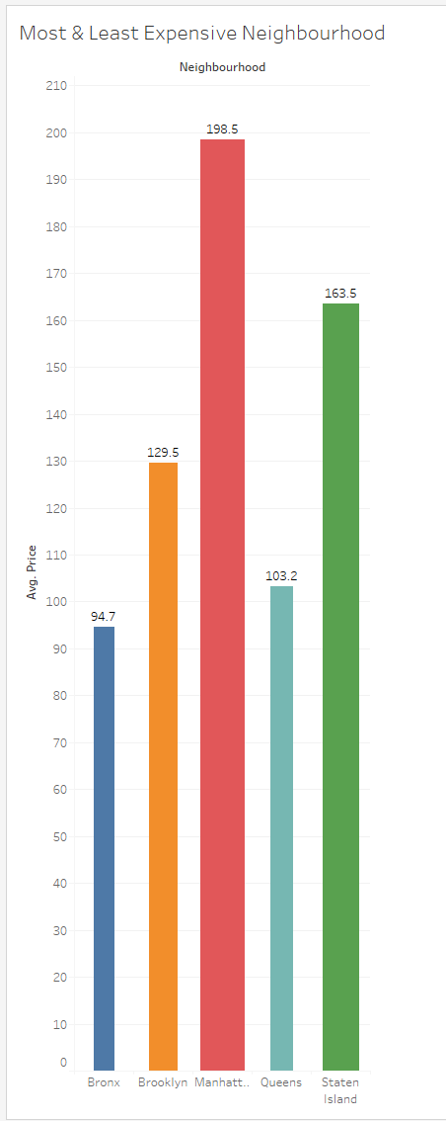
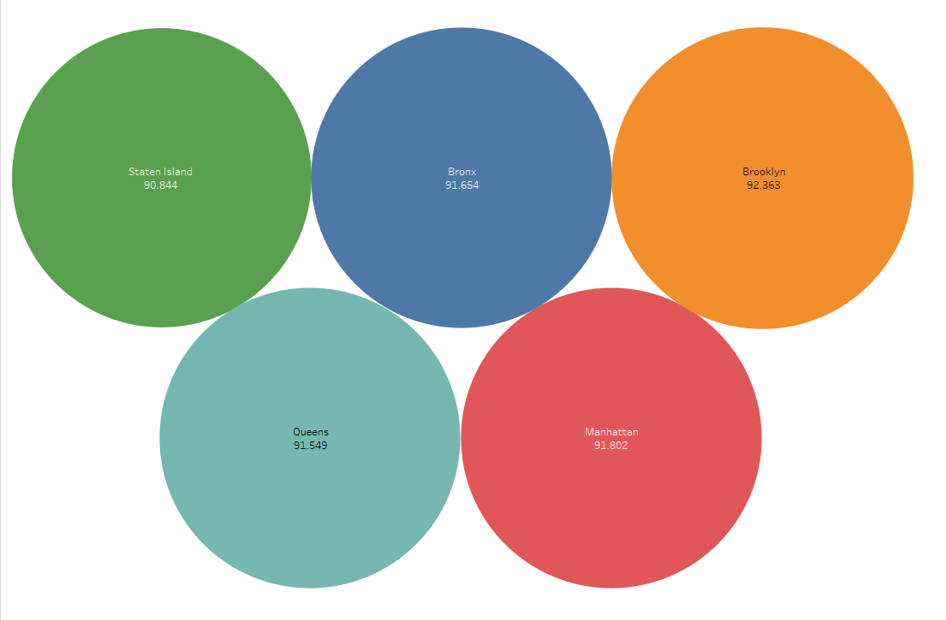
Deep-dive Data Questions I
1. Which neighborhood is the most expensive and least expensive?
2. Which neighborhood has the highest review rating?
3. Is the neighborhood with the highest review rating also the most expensive?
Not really, Average rating is very close in all neighborhoods.

Slide 6
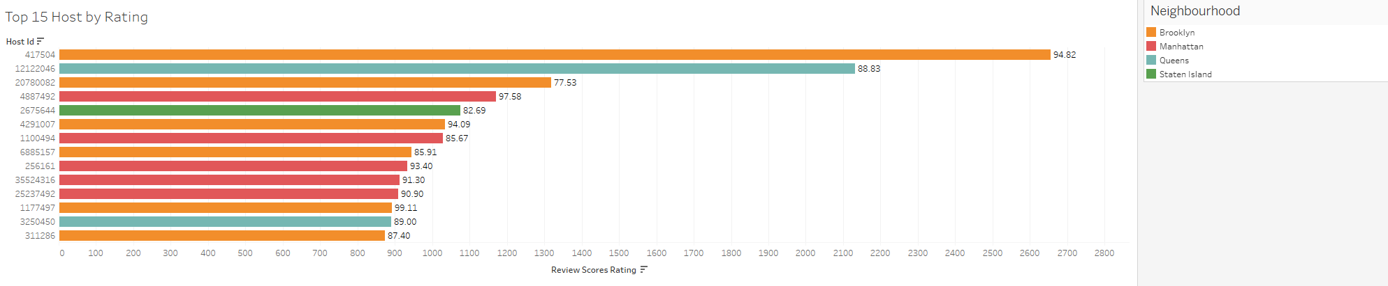
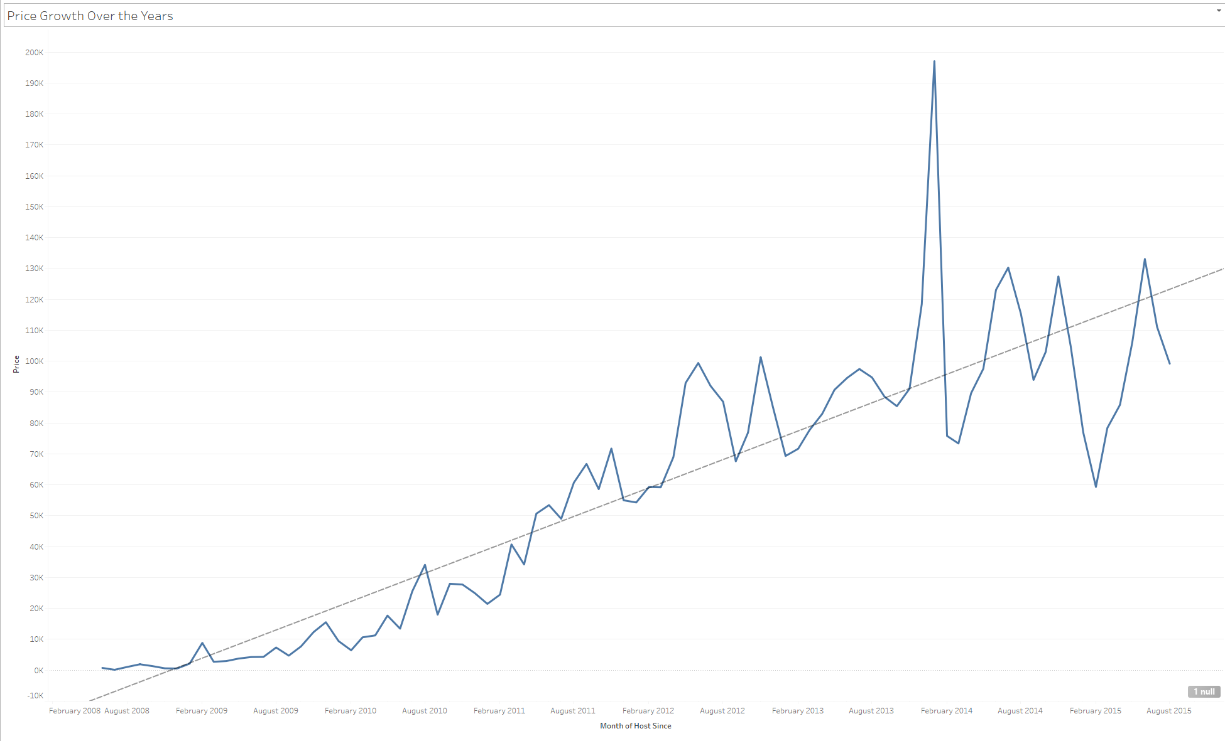
Deep-dive Data Questions II
4. Does the most expensive neighborhood (Manhattan) have the best rated hosts?
No, Brooklyn has the best hosts.
5. How has rental prices increased or decreased over the years?
There have been ups and down in the price, but the overall trend shows growth (increase).

Slide 7
Main Challenge – Time
With more time I would….
Explore functionalities like Parameters and Level of Detail expressions.
Get more information about the dataset, decide and implement the best approach to address null values.
Investigate why some ZIP Codes supposedly for NYC are displaying in Massachusetts, California & Washington DC.

Slide 8

Conclusion
Manhattan neighborhood has the highest number of properties and is the most expensive.
Brooklyn neighborhood has the best hosts.
Apartment property type generates 88% of revenue across all neighborhoods.
Air BnB business shows steady growth in New York City.

Slide 9

https://github.com/AbiAfolabi/Tableau_Project3

Slide 10
5-minute presentations each (on Monday)
Spend 1 min on project flow structure. What were the steps in your project?
Spend 1-2 minutes showing your results. Make sure to highlight:
For Option 1, share the visualizations that you produced in response to the questions.
For Option 2, please share what your main data question was, what you wanted to answer, the dataset you selected, and then explain some of the features of the dataset as well.
Explain the biggest challenges in 1 min.
What would you do if you had a bit more time?
In your presentation, make sure to explain the rationale for the visualizations you selected for either Option 1 or 2.

